Slide 1
Conversion from TPR to EHR
Healthcare Management Capstone - Task TWO
Western Governors University
Cale Gray 000868970
4/15/18
Notes:
Welcome to this strategic planning session. The subject of this presentation is a recommendation for an organizational initiative to replace the hospital’s current Traditional Paper Record system with a modern Electronic Health Record system.

Slide 2
Contents
Summary of Initiative
Stakeholders and Justification
Existing Process – TPR System
Solutions to Process – EHR System
Feasibility of Initiative
Impacts of Initiative
Implementation and Deployment
Monitoring and Controlling Processes
Notes:
To fully consider the organizational initiative to convert from an existing TPR system to an EHR system, this presentation will cover several applicable topics:
Summary of Initiative
Stakeholders and Justification
Existing Process – TPR System
Solutions to Process – EHR System
Feasibility of Initiative
Impacts of Initiative
Implementation and Deployment
Monitoring and Controlling Processes

Slide 3
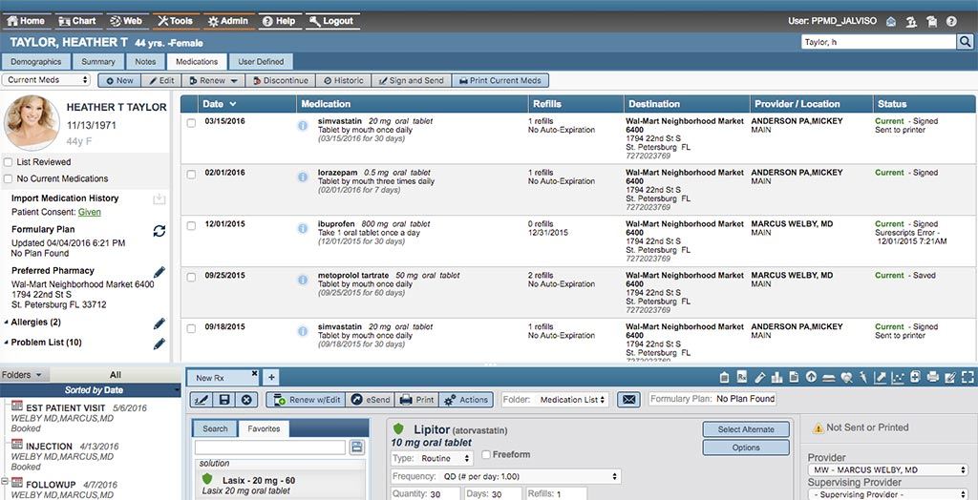
Summary of Initiative
Conversion from Traditional Paper Record (TPR) system to Electronic Health Record system (EHR)
TPR
EHR
Notes:
Due to the many benefits of an EHR system compared to a TPR system, the hospital should immediately begin the conversion process. Some of these benefits include superior record keeping, government incentives, cost savings, and improved patient care. The process will require involvement from several stakeholders within the company to ensure coordination and seamless transition to the new process. While some constraints and risks exist, a successful implementation of an EHR system will result several positive impacts on the organization. After successful implementation, the system will be monitored and controlled through a variety of data-collecting and reporting features built into the EHR software.

Slide 4
Stakeholders and Justification
Position | Justification for Involvement
Health Information Manager | System integration, hardware, software
Director of Nursing | Functionality and features
Chief Medical Officer | General quality of care issues
Chief Financial Officer | Costs and profitability
Director of Support Services | Training
Chief Executive Officer | General oversight and PR
Owner | General oversight and PR
Notes:
There are several internal stakeholders who will be involved in this organizational initiative.
One important stakeholder is the Health Information Manager. The HIM will oversee the IT department in security, integration, hardware and software issues.
Another key stakeholder is the Director of Nursing. The nursing director and the staff of nurses will be interested in the functionality and features of the new system.
A third key stakeholder is the Chief Medical Officer. The CMO will provide input regarding how the EHR system will ultimately improve quality of care at the hospital.
The Chief Financial Officer will also be involved. He will provide input regarding costs and profitability of the system.
The Director of Support Services will be heavily involved in the process of training employees on use of the new system.
Other stakeholders include the owner and the Chief Executive Officer who will assist in general oversight and public relations.

Slide 5
Existing Process – TPR System
Weaknesses of Traditional Paper Records
Managing paper files
Physicians must be on location to access information
Slow transmission of records
Data entry for administrative staff
Notes:
The existing process being performed today is the use of TPR system. A TPR system involves paper records being managed on site by the administrative staff. The process includes: obtaining handwritten records from patients; filing and organizing paper records; and transmitting records via fax machines or mail. Because of the weaknesses, a TPR system is costly, time consuming, and inhibiting of patient care.

Slide 6
Solutions to Process – EHR System
Strengths of Electronic Health Records
Databases of records
Features to support patient care
Secure and instant transmission of records
Physicians can remotely access patient records
Notes:
A modern EHR system offers several solutions that it make it vastly superior to TPR. These solutions include: records being stored in electronic databases; software solutions to improve patient care; encryption features for electronic transmission of records; and the ability of physicians to access patient records remotely.

Slide 7
Feasibility of Initiative
Risks/Constraints
Costs
Conversion of old data
Employee training on new system
Security of PHI
Possibility of technical issues
Notes:
The organizational initiative to adopt an EHR system will involve some constraints and risks, however the initiative is both feasible and necessary for the organization.
Some constraints affecting feasibility that should be considered are: capital to pay for the initiative; a process of converting legacy data to new system; and the cost of providing training for all employees.
Some of the risks that should be considered are: risks to network security affecting PHI; and risk of technical issues arising during the initiative. Despite these risks and constraints it is still feasible for the organization to take on this initiative.

Slide 8
Impacts of Initiative
Internal | External
Improved patient care | Robust network with other providers using EHR
Profit increases | Competitive advantage vs providers still using TPR
Fewer typo-related errors
Improved portability of records
Notes:
The completion of the initiative will have several impacts for the hospital. Some external impacts are: a more robust electronic network that can interact with other providers; and an increase in competitive advantage in the market over hospitals that haven’t yet adopted an EHR system.
Some internal impacts of the new EHR system on the hospital are: improved patient care through software features; profit increases from fewer errors and duplications; and improved record portability through database and encryption features.

Slide 9
Implementation and Deployment
Notes:
The strategy for implementation of the new EHR system includes: several security audits; hardware and infrastructure updates; incorporation of legacy data; and execution of a company-wide training plan for the new system.
Deployment will take place over three phases. The first phase will include capabilities analysis of network, finances, and hardware.
The second phase will include hardware upgrades; data conversion to central repository; security system upgrades; and launch of training program.
The third phase of deployment will involve software installation and configuration on all hospital devices; creation of login credentials for employees; and a series of tests to confirm functionality and security.

Slide 10
Monitoring and Controlling Processes
EHR Generated Reports
Impact on finances, patient care, and security
Strategic plan adjustments
Ongoing security audits
Notes:
Monitoring and controlling of the initiative will be primarily provided by data collection and reporting features of the new system. Data from the EHR reporting system will be analyzed by each department according to their respective areas of jurisdiction. During this analysis there will be ongoing security audits to confirm network security. The strategic team will use the analyzed data to make adjustments to the strategic plans of the organization.

